Slide 1
Balanced Binary Search Trees
Marzieh Eskandari
NJIT

Slide 2
Binary Search Tree
25
15
30
10
18
28
40
5
20
35
50
Binary Search Tree Property: key of a node is less than the keys of its right subtree and greater than the keys of its left subtree.

Slide 3
Methods
Search(k): O(h)
Insert(k) : O(h)
Delete(k) : O(h)
25
15
30
h
10
18
28
40
5
20
35
50

Slide 4
Bad Trees for Search
7
7 | 11 | 15 | 17 | 24 | 39 | 40 | 56 | 65 | 78

Slide 5
Bad Trees for Search
7
7 | 11 | 15 | 17 | 24 | 39 | 40 | 56 | 65 | 78
11
15
17
24
h=n
39
40
56
65
78

Slide 6
Good Trees for Search
25
h=log n
15
30
10
18
28
40
In order to avoid the poor performance, we need ways of maintaining the height of a search tree to be logarithmic in the number of nodes it has.

Slide 7
Generalization
44
17
78
15
nil
32
50
88
48
62

Slide 8
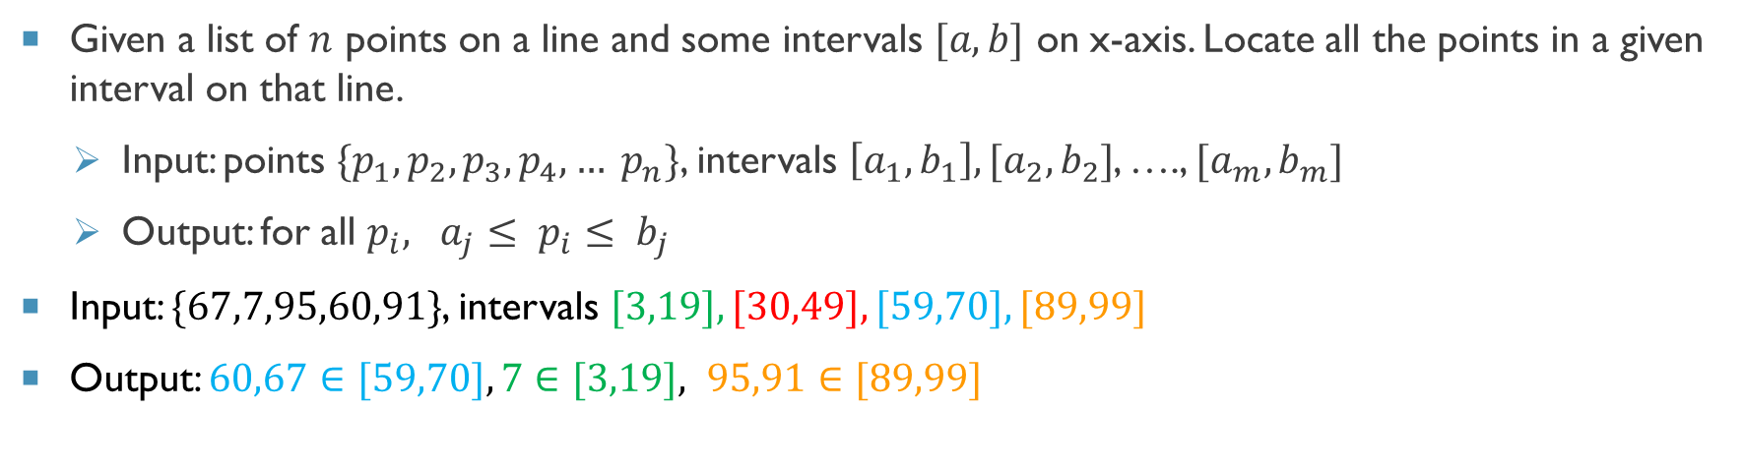
Empty External Nodes
Given a list of $n$ points on a line and some intervals $[a,b]$ on x-axis. Locate all the points in a given interval on that line.
Input: points $\{p_{1}, p_{2}, p_{3}, p_{4}, … p_{n}\}$, intervals $\left[a_{1}, b_{1}\right],[a_{2}, b_{2}]$, …., $[a_{m}, b_{m}]$
Output: for all $p_{i}, a_{j}≤ p_{i}≤ b_{j}$
Input: $\{67,7,95,60,91\}$, intervals $[3,19], [30,49], [59,70], [89,99]$
Output: $60,67∈[59,70],7∈[3,19], 95,91∈[89,99]$
[ ] [ ] [ ] [ ]

Slide 9
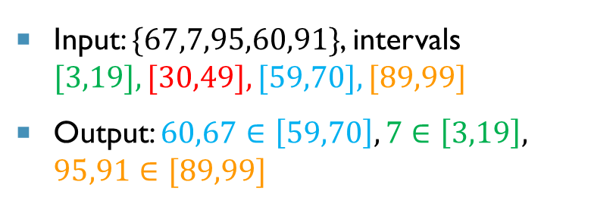
Empty External Nodes
Input: $\{67,7,95,60,91\}$, intervals $[3,19], [30,49], [59,70], [89,99]$
Output: $60,67∈\left[59,70\right],7∈\left[3,19\right], 95,91∈[89,99]$
49
19
70
15
3
30
59
89
3
19
30
49
59
70
89
99
[ ] [ ] [ ] [ ]

Slide 10
How to make the Tree?
Sort the intervals
Pair them
49
19
70
3
30
59
89
3
19
30
49
59
70
89
99
parent value is max of left’s leaves

Slide 11
Definition
Rank-balanced tree is a binary tree with logarithmic height.
AVL trees
Red-black trees
By performing a certain kind of restructuring actions (rotation), we change a tree to a rank-balanced tree.

Slide 12
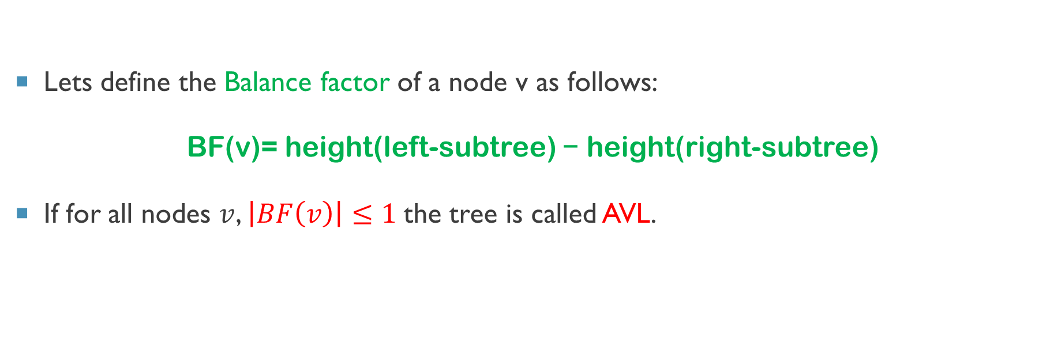
Balance Factor
Lets define the Balance factor of a node v as follows:
BF(v)= height(left-subtree) − height(right-subtree)
If for all nodes $v$, $\left|BF\left(v\right)\right|≤1$the tree is called AVL.

Slide 13
AVL: Example
44
4
heights
3
17
2
78
15
1
2
32
50
88
1
0
1
1
48
62
0
0
0
0
0
0
0
0

Slide 14
AVL: Example
-1
44
4
Balance factor
1
-1
3
17
2
78
15
0
0
1
2
0
0
32
50
88
1
0
1
0
0
1
48
62
0
0
0
0
0
0
0
0
0
0
0
0
0
0
0
0

Slide 15
AVL: Example
-1
44
Balance factor
1
-1
17
78
15
0
0
0
32
50
88
0
0
0
48
62
0
0
0
0
0
0
0
0

Slide 16
Rotations
An AVL tree may perform the following four kinds of rotations, when it is getting unbalanced:
Single rotations
Left rotation
Right rotation
Double rotations
Left-Right rotation
Right-Left rotation

Slide 17
Rotations?
A
B
Rotation at A
B
A
C
C

Slide 18
Insertion
By changing the way a key is inserted to a tree, the tree would be an AVL.
Insert new key as usual
If tree is not an AVL, Perform a rotation

Slide 19
AVL: Example
1. Insert(54)
-1
44
1
-1
17
78
15
0
0
0
32
50
88
0
0
0
48
62
0
0
0
0
0
0
0
0

Slide 20
AVL: Example
1. Insert(54)
-1
44
1
-1
17
78
15
0
0
0
32
50
88
0
0
0
48
62
0
0
0
0
0
0
0
0

Slide 21
AVL: Example
1. Insert(54)
-1
44
1
-1
17
78
15
0
0
0
32
50
88
0
0
0
48
62
0
0
0
x
0
0
54
0
0
0
0
0

Slide 22
Is tree still an AVL?
On the path from new node (x) to the root, update the balance factors.

Slide 23
AVL: Example
1. Insert(54)
2. Update BFs
-2
44
2
-1
17
78
15
0
0
-1
32
50
88
0
0
1
48
62
0
0
0
x
0
0
54
0
0
0
0
0

Slide 24
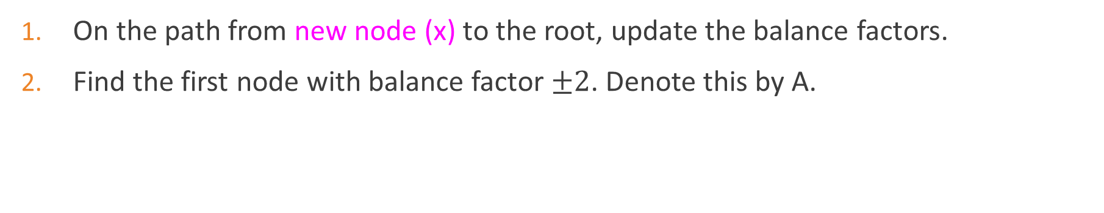
Is tree still an AVL?
On the path from new node (x) to the root, update the balance factors.
Find the first node with balance factor $±2$. Denote this by A.

Slide 25
AVL: Example
1. Insert(54)
2. Update BFs
3. Find the first
ancestor with
BF of 2
-2
44
A
2
-1
17
78
15
0
0
-1
32
50
88
0
0
1
48
62
0
0
0
x
0
0
54
0
0
0
0
0

Slide 26
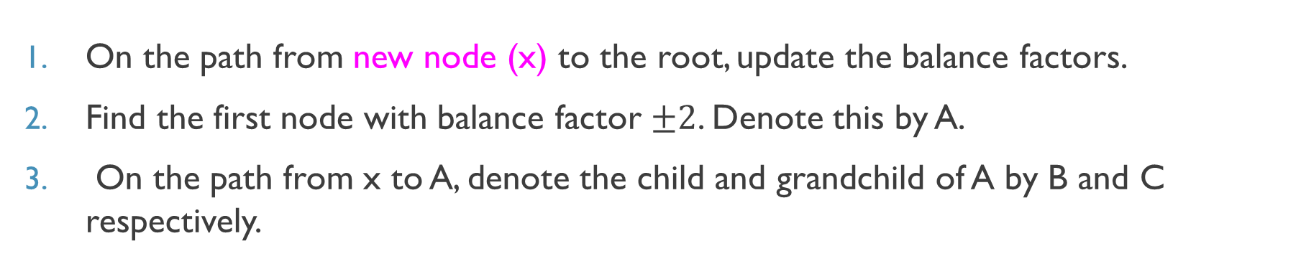
Is tree still an AVL?
On the path from new node (x) to the root, update the balance factors.
Find the first node with balance factor $±2$. Denote this by A.
On the path from x to A, denote the child and grandchild of A by B and C respectively.

Slide 27
AVL: Example
1. Insert(54)
2. Update BFs
3. Find the first
ancestor with
BF of 2
4. B and C?
-2
44
A
2
-1
17
78
15
0
0
-1
32
50
88
0
0
1
48
62
0
0
0
x
0
0
54
0
0
0
0
0

Slide 28
AVL: Example
1. Insert(54)
2. Update BFs
3. Find the first
ancestor with
BF of 2
4. B and C: Rotaion?
-2
44
A
2
-1
17
78
15
0
0
-1
B
32
50
88
0
0
C
1
48
62
0
0
0
x
0
0
54
0
0
0
0
0

Slide 29
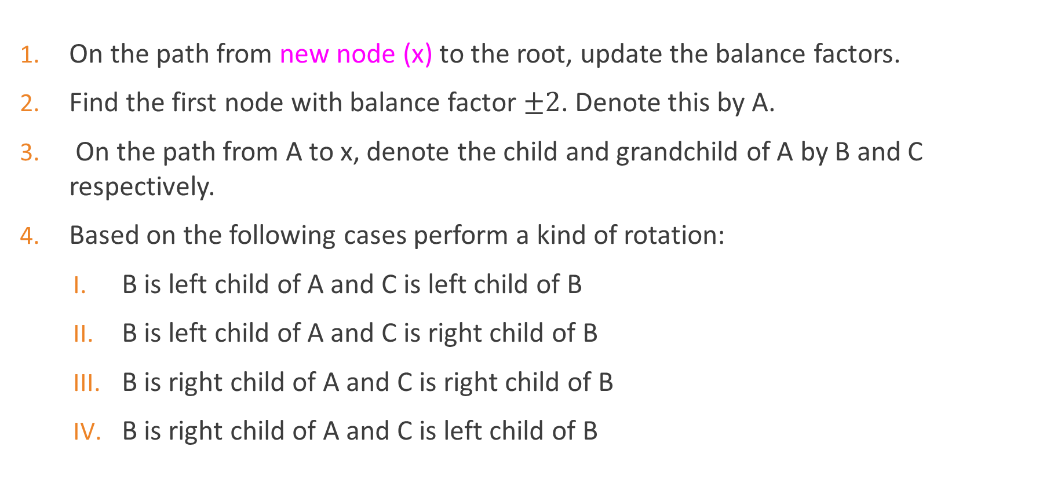
Is tree still an AVL?
On the path from new node (x) to the root, update the balance factors.
Find the first node with balance factor $±2$. Denote this by A.
On the path from A to x, denote the child and grandchild of A by B and C respectively.
Based on the following cases perform a kind of rotation:
B is left child of A and C is left child of B
B is left child of A and C is right child of B
B is right child of A and C is right child of B
B is right child of A and C is left child of B

Slide 30
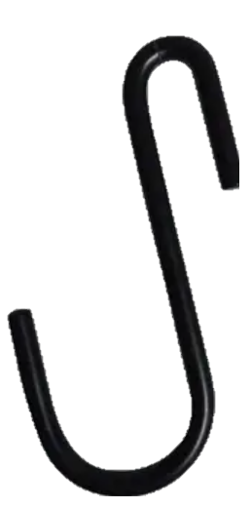
Left rotation
-2
A
B
Left Rotation at A
B
A
C
C
x
.
x

Slide 31
Right rotation
2
A
B
B
Right Rotation at A
C
A
C
x
.
x

Slide 32
Right-Left rotation
-2
A
C
B
A
B
C
x
.
x

Slide 33
Left-Right Rotation
2
A
C
B
B
A
C
x
.
x

Slide 34
AVL: Example
1. Insert(54)
2. Update BFs
3. Find the first
ancestor with
BF of 2
4. Determine the rotation
-2
44
A
2
-1
17
78
15
0
0
-1
B
32
50
88
0
0
C
1
48
62
0
0
0
x
0
0
54
0
0
0
0
0

Slide 35
AVL: Example
1. Insert(54)
2. Update BFs
3. Find the first
ancestor with
BF of 2
4. Perform the rotation
-2
44
C
-1
-1
17
15
62
0
2
1
A
B
32
78
50
0
0
0
x
54
88
48
0
0
0
0
0
0
0
0
0
0

Slide 36
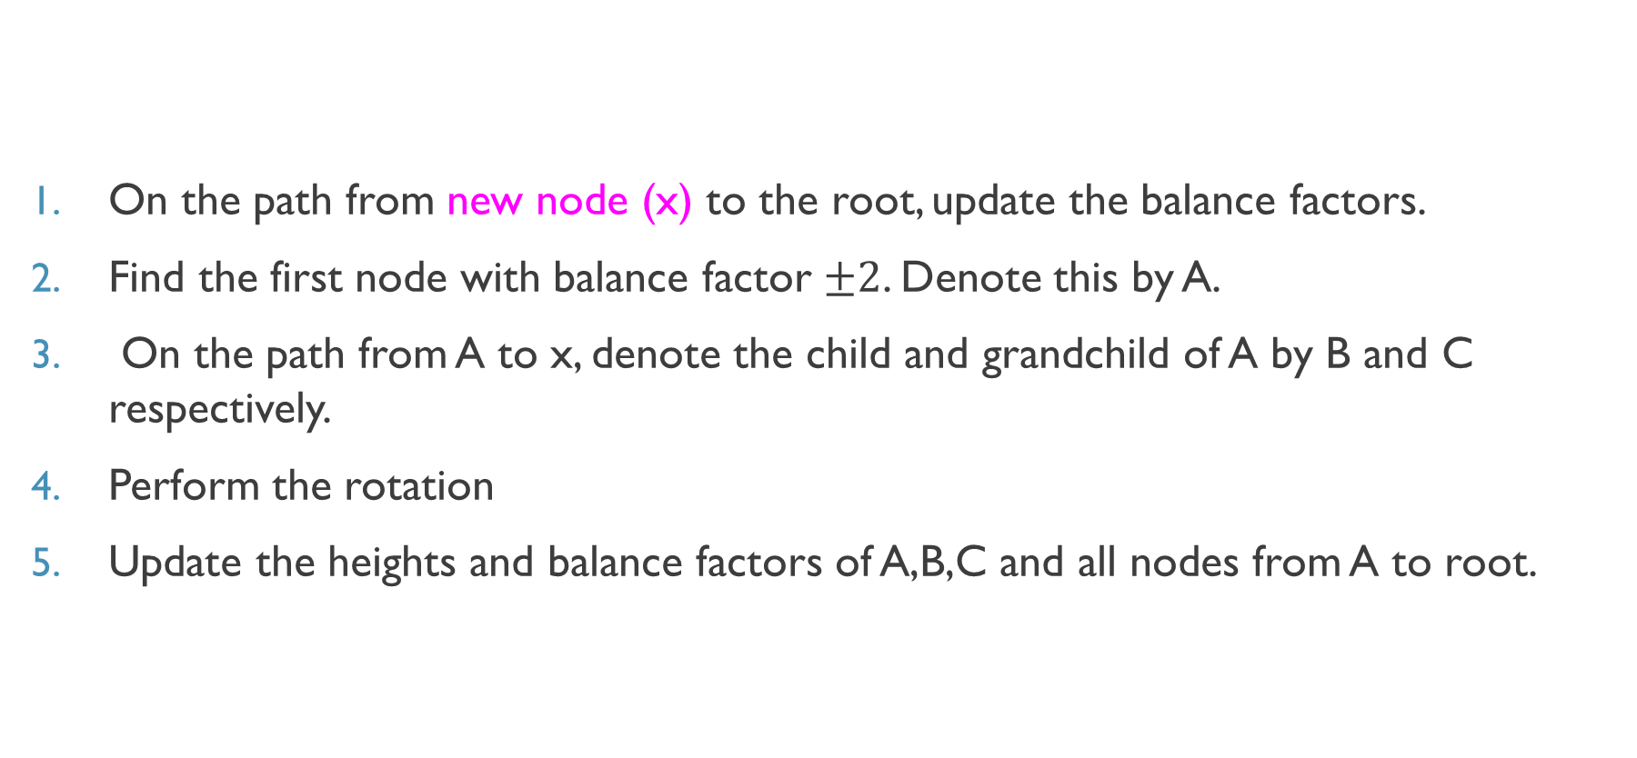
Is tree still an AVL?
On the path from new node (x) to the root, update the balance factors.
Find the first node with balance factor $±2$. Denote this by A.
On the path from A to x, denote the child and grandchild of A by B and C respectively.
Perform the rotation
Update the heights and balance factors of A,B,C and all nodes from A to root.

Slide 37
AVL: Example
1. Insert(54)
2. Update BFs
3. Find the first
ancestor with
BF of 2
4. Perform the rotation
5. Update heights
and BFs
-1
44
C
0
-1
17
15
62
0
-1
0
A
B
78
32
50
0
0
0
x
54
88
48
0
0
0
0
0
0
0
0
0
0

Slide 38
Removal
By changing the way a key is deleted from a tree, it would remain an AVL.
Delete the key as usual
It tree is not an AVL, Perform a rotation

Slide 39
Remove
Delete the node as usual (BST deletion). Let x be the physically deleted node.
Set current_node = x. parent
While current_node ≠ NULL, do the following:
Set p = current_node.parent
Update height and balance factor of current_node.
If current_node is unbalanced then
Let A = current_node (first unbalanced node).
Let B = taller child of A.
Let C = taller child of B (or same-side child if equal height).
Perform rotation based on B and C's positions relative to A.
Update heights/Balance factors after the rotation.
Move upward: current_node = p
A
B
x.parent

Slide 40
Remove: how to find C?
Let C = taller child of B (or same-side child if equal height).
A
A
B
B
C
C

Slide 41
Remove: how to rotate?
Perform rotation based on B and C's positions relative to A:
B is the left child of A and C is the left child of B (LL Case) : Right Rotate(A)
B is the left child of A and C is the right child of B (LR Case) : Left Rotate(B) → Right Rotate(A)
B is the right child of A and C is the right child of B (RR Case): Left Rotate(A)
B is the right child of A and C is the left child of B (RL Case): Right Rotate(B) → Left Rotate(A)

Slide 42
AVL: Example
1. delete(32)
-1
44
-1
0
17
15
62
0
-1
0
32
78
50
0
0
0
54
88
48
0
0
0
0
0
0
0
0
0
0

Slide 43
AVL: Example
1. delete(32)
-1
44
-1
0
17
15
Current_node
62
-1
0
78
50
0
0
0
0
54
88
Current_node=parent of 32
48
0
0
0
0
0
0
0
0

Slide 44
AVL: Example
delete(32)
Update its BF
-1
44
0
0
17
15
Current_node
62
-1
It is balanced!
0
78
50
0
0
0
0
54
88
48
0
0
0
0
0
0
0
0

Slide 45
AVL: Example
delete(32)
Update its BF
-1
44
Current_node
0
0
17
15
62
-1
0
78
50
0
0
0
0
54
88
48
0
0
0
0
0
0
0
0

Slide 46
AVL: Example
delete(32)
Update its BF
-2
44
Current_node
0
0
17
15
62
-1
It is not balanced!
0
78
50
0
0
0
0
54
88
48
0
0
0
0
0
0
0
0

Slide 47
AVL: Example
delete(32)
Update its BF
A= current_node
-2
44
Current_node
0
A
0
17
15
62
-1
0
78
50
0
0
0
0
54
88
48
0
0
0
0
0
0
0
0

Slide 48
AVL: Example
delete(32)
Update its BF
A= current_node
Determin B
-2
44
Current_node
0
A
B
0
17
15
62
-1
0
78
50
0
0
0
0
54
88
48
0
0
0
0
0
0
0
0

Slide 49
AVL: Example
delete(32)
Update its BF
A= current_node
Determin B
Determine C
-2
44
Current_node
0
A
B
0
17
15
62
-1
0
C
78
50
0
0
0
0
54
88
48
0
0
0
0
0
0
0
0

Slide 50
AVL: Example
delete(32)
Update its BF
A= current_node
Determin B
Determine C
Determine the rotation
-2
44
Current_node
0
A
B
0
17
15
62
-1
0
C
78
50
0
0
0
0
54
88
48
0
0
0
0
0
0
0
0

Slide 51
AVL: Example
delete(32)
Update its BF
A= current_node
Determin B
Determine C
Perform the rotation
B
0
62
-1
A
C
78
-2
44
0
0
0
0
88
17
50
0
0
48
54
0
0
0
0
0
0
0
0
0

Slide 52
AVL: Example
delete(32)
Update its BF
A= current_node
Determin B
Determine C
Perform the rotation
Update BFs of A,B,C
B
1
62
-1
A
C
78
-1
44
0
0
0
0
88
17
50
0
0
48
54
0
0
0
0
0
0
0
0
0

Slide 53
AVL: Example
delete(32)
Update its BF
A= current_node
Determin B
Determine C
Perform the rotation
Update BFs of A,B,C
Repeat from parent of current_node until we reach NULL!
B
1
62
-1
A
C
78
-1
44
0
0
0
0
88
17
50
0
0
44 was root and its parent was Null, so we are done!
48
54
0
0
0
0
0
0
0
0
0

Slide 54
AVL: Insert/ DElete
AVL.Insert
1. Insert node x as usual.
2. On the path from x to the root, update the balance factors to find the first unbalance node (A).
3. Determine B and C and perform rotation. 4. Update the heights and balance factors of nodes A, B, and C. Continue updating the heights and balance factors on the path from node A up to the root.
AVL.Delete
1. Delete node x as usual.
2. Set current_node = x.parent.
3. While current_node ≠ NULL:
a. Update height and balance factor of current_node.
b. If current_node is unbalanced:
Determine A,B,C and perform rotation
Update heights and balance factors after rotation.
Set current_node = current_node.parent.

Slide 55
Red-Black Tree
Red-black tree is a binary search tree that satisfies the following properties:
Every node is either red or black.
The root is black
Every external node is black.
Both children of a red node are black.
For each node, all paths from the node to its descendant leaves (nil nodes) contain the same number of black nodes.

Slide 56
Red-Black Tree
Every node is either red or black.
The root is black
Every external node is black.
Both children of a red node are black.
For each node, all paths from the node to its nil nodes contain the same number of black nodes.
12
5
15
3
10
13
17
4
7
11
14
6
8

Slide 57
Red-Black Tree
Every node is either red or black.
The root is black
Every external node is black.
Both children of a red node are black.
For each node, all paths from the node to its nil nodes contain the same number of black nodes.
12
5
15
3
10
13
17
4
7
11
14
Black height of node 10 is 2
6
8

Slide 58
Red-Black Tree
Every node is either red or black.
The root is black
Every external node is black.
Both children of a red node are black.
For each node, all paths from the node to its nil nodes contain the same number of black nodes.
12
5
15
3
10
13
17
4
7
11
14
Black height of node 3 is 1
6
8

Slide 59
Black height of RBT
12
Black height of root is 3
5
15
3
10
13
17
4
7
11
14
6
8
54/89
Notes:
bh=B-1, h=R+B-1, R<=B-1=>h=R+bh, R<=bh=> h=R+bh<=2bh

Slide 60
Violations!
12
“Black height” violation!
5
15
3
10
13
17
4
7
11
14
6
8
54/89

Slide 61
Violations!
12
5
15
“Double red” violation!
3
10
13
17
4
7
11
14
6
8
54/89

Slide 62
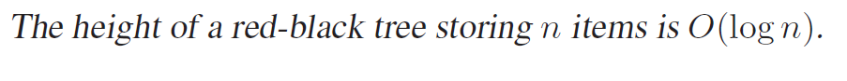
Red-Black Tree

Slide 63
Insertion
Insert the new key as usual
Paint the new node.
If tree is not a RBT, perform rotations and/or recolorings!

Slide 64
Insertion
Insert the new key as usual
If the new node is the root, color it black and we are done! Otherwise color it red.
If its parent is black, nothing else needs to be done, we are done!
Otherwise, that means a “double red” violation of red-black tree rules, which needs to be fixed.

Slide 65
Insertion: Example
Insert 12
33
13
53
11
21
41
61
15
31
8

Slide 66
Insertion: Example
Insert 12
33
13
53
11
21
41
61
15
31
8

Slide 67
Insertion: Example
Insert 12
33
13
53
11
21
41
61
If its parent is black, we are done.
12
15
31
8

Slide 68
Insertion: Example
Insert 50
33
13
53
11
21
41
61
15
31
8

Slide 69
Insertion: Example
Insert 50
33
13
53
11
21
41
61
15
31
8

Slide 70
Insertion: Example
Insert 50
33
13
53
11
21
41
61
If its parent is red, rebalance!
15
31
50
8

Slide 71
Rebalancing RBT after insertion
Grandparent of x
G
P
U
Uncle of x
Parent of x
X

Slide 72
Insert
Uncle
Red
Black
G
Invert the colors of P,G,U
Start over with G
X-P-G
P
U
Triangle
Line
X
Perform a rotation at P
X=P
Change the colors of P, G
Perform a rotation at G

Slide 73
Rebalancing RBT after insertion
G
P
U
X
What color is the grandparent?

Slide 74
Rebalancing RBT after insertion
G
P
U
X

Slide 75
Rebalancing RBT after insertion: two cases
G
G
Uncle of x
Uncle of x
P
U
P
U
X
X

Slide 76
Rebalancing
1. Uncle of x is red 2. Uncle of x is black
x
x
x

Slide 77
uncle is red
G
G
P
U
P
U
x
x
Change the colors of P,G,U: Black height does not change.
Step 1 may form double-red if parent of G is red. So, we start over with G as a newly-red node.

Slide 78
uncle is red
New node
G
G
P
U
P
U
x
x
Change the colors of P,G,U: Black height does not change.
Step 1 may form double-red if parent of G is red. So, we start over with G as a newly-red node.

Slide 79
uncle is black : Triangle
G
Transform triangle case to the line case!
P
U
x

Slide 80
uncle is black : Triangle
G
Perform a rotation on the parent of x:
If parent is a left child: Left rotation is needed, otherwise, right rotation
P
U
x
Since both x and its parent are red, so rotation won't affect the black height.

Slide 81
uncle is black : Triangle
G
G
G
rotation on the parent to
transform to line
(here left rotation)
P
U
P
x
U
U
x
P
x

Slide 82
uncle is black : Triangle
G
B
G
rotation on the parent
P
U
P
x
U
U
New node
x
P
x

Slide 83
uncle is black : line
G
P
U
x

Slide 84
uncle is black : line
Change the colors of parent and grandparent
G
P
U
x

Slide 85
uncle is black : line
Change the colors of parent and grandparent
perform a rotation at the grandparent to rebalance
G
G
P
U
P
U
x
x

Slide 86
uncle is black : line
Change the colors of parent and grandparent
perform a rotation at the grandparent to rebalance
G
G
P
P
U
P
U
x
G
x
x
x
U

Slide 87
Insert
Uncle
Red
Black
G
Invert the colors of P,G,U
Start over with G
X-P-G
P
U
Triangle
Line
X
Perform a rotation at P
X=P
Change the colors of P, G
Perform a rotation at G

Slide 88
Insertion: Example
Insert 20
33
13
53
11
21
41
61
15
31
8

Slide 89
Insertion: Example
Insert 20
33
13
53
11
21
41
61
15
31
8

Slide 90
Insertion: Example
Insert 20
33
13
53
11
21
41
61
15
31
it is not a RB tree because 15 has a red child
20
8
8

Slide 91
Insertion: Example
Insert 20
33
13
53
11
21
41
61
15
31
x
20
8
8

Slide 92
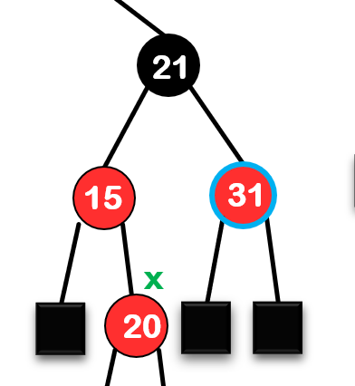
Insert
Uncle
Red
Black
Invert the colors of P,G,U
Start over with G
X-P-G
Triangle
Line
Perform a rotation at P
X=P
Change the colors of P, G
Perform a rotation at G

Slide 93
Insertion: Example
Insert 20
33
13
53
11
21
41
61
15
31
x
20
8
8

Slide 94
Insertion: Example
Insert 20
33
13
53
11
21
41
61
15
31
20
8
8

Slide 95
Insertion: Example
Insert 20
33
13
53
x
11
21
41
61
15
31
20
8
8

Slide 96
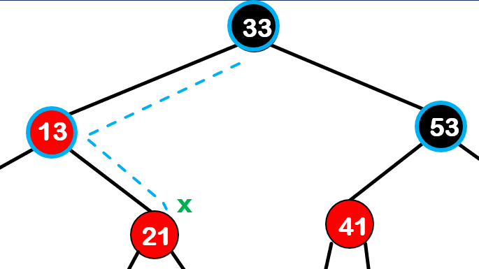
Insert
Uncle
Red
Black
Invert the colors of P,G,U
Start over with G
X-P-G
Triangle
Line
Perform a rotation at P
X=P
Change the colors of P, G
Perform a rotation at G

Slide 97
Insertion: Example
Insert 20
33
13
53
Uncle is black
x
11
21
41
61
Triangle: Transform to line
15
31
Left rotation at parent of x Start over with p
20
8
8

Slide 98
Insertion: Example
Insert 20
33
21
53
Uncle is black
x
13
31
41
61
Triangle: Transform to line
11
15
Left rotation at parent of x
Start over with p
20
8

Slide 99
Insertion: Example
Insert 20
33
21
53
Uncle is black
x
13
31
41
61
Line
11
15
20
8

Slide 100
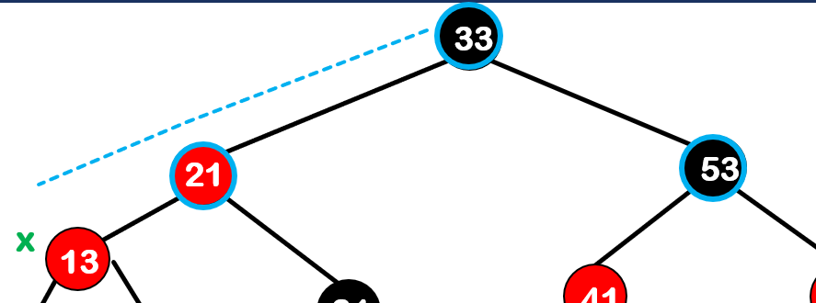
Insert
Uncle
Red
Black
Invert the colors of P,G,U
Start over with G
X-P-G
Triangle
Line
Perform a rotation at P
X=P
Change the colors of P, G
Perform a rotation at G

Slide 101
Insertion: Example
Insert 20
33
21
53
Uncle is black
x
13
31
41
61
Line
11
15
Change the colors of G and P
20
8

Slide 102
Insertion: Example
Insert 20
33
21
53
Uncle is black
x
13
31
41
61
Line
11
15
Change the colors of G and P
20
8
Do a right rotation at G: 33

Slide 103
Insertion: Example
Insert 20
21
13
33
Uncle is black
11
15
31
53
Line
20
41
61
8
color the parent black and
the grandparent red
Do a right rotation at the grandparent: 33

Slide 104
Pseudocode
Perform standard BST insertion and set the color of the newly inserted node (denoted by x) to RED.
If x is the root, change the color of x to BLACK.
while x.parent.color == Red: a) if x.uncle.color == RED: (i) x.parent.color=BLACK , x.uncle.color=BLACK, x.grandparent.color=RED. (ii) x = x.grandparent. b) elif x.uncle.color==BLACK, there are four possible cases:
Line: Swap the colors of x.parent and x.grandparent, perform a right rotation at the grandparent
Triangle: Perform a left rotation at x.parent, x=x.parent
Line: Swap the colors of x.parent and x.grandparent, perform a left rotation at the grandparent
Triangle: Perform a right rotation at x.parent, x=x.parent
root.color=BLACK
Notes:
100,50,10

Slide 105
Removal
Note that when we perform standard delete operation in BST, there are three cases for the node that should be deleted :
It has no children
It has only one child
It has two children
In each case, we always end up deleting a node that is either a leaf or has only one child. This is clear for cases 1 and 2. In case 3, we copy the data (not the color!) of the smallest successor on the right to the node that should be deleted, and then we delete that successor, which is either a leaf or has only one child (see figure).

Slide 106
1. No children
25
25
Delete(28)
15
30
15
30
28
40
40
Should be deleted
35
50
35
50

Slide 107
2. One child
25
25
Delete(18)
15
30
15
30
Should be deleted
10
18
10
20
5
20
5

Slide 108
3. Two children
20
20
Delete(55)
55
60
70
70
65
65
60
63
Physically should be deleted
63

Slide 109
Removal
Let x be the node that is to be physically deleted.
If x is red, then nothing else needs to be done.
If x is black and has a single red child, then we turn the single child to black and we are done.
Otherwise, deletion of a black node causes a shortage in the number of black nodes, which needs to be fixed.
Notes:
Removing a red node cannot cause either a dbl red violation or a blk height voilation

Slide 110
Removal
Let x be the node that is to be physically deleted.
If x is red, then nothing else needs to be done.
If x is black and has a single red child, then we turn the single child to black and we are done.
Notes:
Removing a red node cannot cause either a dbl red violation or a blk height voilation

Slide 111
Removal
Let x be the node that is to be physically deleted.
If x is red, then nothing else needs to be done.
If x is black and has a single red child, then we turn the single child to black and we are done.
Notes:
Removing a red node cannot cause either a dbl red violation or a blk height voilation

Slide 112
Removal
Let x be the node that is to be physically deleted.
If x is red, then nothing else needs to be done.
If x is black and has a single red child, then we turn the single child to black and we are done.
Otherwise, deletion of a black node causes a shortage in the number of black nodes, which needs to be fixed.
Notes:
Removing a red node cannot cause either a dbl red violation or a blk height voilation

Slide 113
Deletion: Example 1
Delete 41
33
If x is red, then nothing else needs to be done.
13
53
11
21
41
61
15
31
8

Slide 114
Deletion: Example 1
Delete 41
33
13
53
11
21
61
15
31
8

Slide 115
Deletion: Example 2
Delete 53
33
If x is black and has a single red child, then we turn the single child to black and we are done.
13
53
11
21
61
15
31
8

Slide 116
Deletion: Example 2
Delete 53
33
If x is black and has a single red child, then we turn the single child to black and we are done.
13
61
11
21
15
31
8

Slide 117
Deletion: Example 2
Delete 53
33
If x is black and has a single red child, then we turn the single child to black and we are done.
13
61
11
21
15
31
8

Slide 118
Deletion: Example 3
Delete 11
33
If x is black and does not have a red child: shortage in the number of black nodes, which needs to be fixed.
53
13
11
21
41
61
15
31
8

Slide 119
Deletion: Example 3
Delete 11
33
If x is black and does not have a red child: shortage in the number of black nodes, which needs to be fixed.
53
13
21
41
61
15
31
8

Slide 120





Removal: x is right child
parent
$$p$$
Sibling
$$s$$
$$x$$
$$l$$
$$r$$
Suppose 𝑥 is the right-child of its parent. (The case that it is the left child is mirror image.)

Slide 121
Removal: Cases
Sibling
Red
Black
Sibling
x
children
rotation
recoloring
red left
red right
both black
rotation
recoloring
rotation
recoloring
parent
red
black
recoloring
recoloring

Slide 122





Removal 1: sibling is red
$$p$$
$$s$$
$$x$$
$$l$$
$$r$$

Slide 123



Removal 1: sibling is red
$$p$$
$$s$$
$$x$$
$$l$$
$$r$$

Slide 124





Removal 1: sibling is red
$$p$$
$$s$$
Right rotation at p
$$s$$
$$x$$
$$l$$
$$p$$
$$l$$
$$r$$
$$r$$
$$x$$

Slide 125

Removal 1: sibling is red
$$p$$
$$s$$
Change the colors of p and s
$$s$$
$$x$$
$$l$$
$$p$$
Sibling
$$l$$
$$r$$
$$r$$
$$x$$
Sibling is black, one of the other cases will apply to terminate

Slide 126

Removal 2: sibling is Black with a red left child
$$p$$
$$s$$
$$x$$
$$l$$
$$r$$

Slide 127


Removal 2: sibling is Black with a Red left child
$$p$$
$$s$$
1. Right rotation at p
$$s$$
$$x$$
$$l$$
$$p$$
$$l$$
$$r$$
$$r$$
$$x$$

Slide 128


Removal 2: sibling is Black with a red left Child
$$p$$
$$s$$
2. s keeps the original color of p
$$s$$
$$x$$
$$l$$
$$p$$
3. $l$ and $p$ are changed to black
$$l$$
$$r$$
$$r$$
$$x$$
Final result

Slide 129
Removal 3: sibling is Black with a red right child
$$p$$
$$s$$
$$x$$
$$l$$
$$r$$

Slide 130


Removal 3: sibling is Black with a red right child
$$p$$
$$s$$
$$x$$
$$l$$
$$r$$
$$c_{1}$$
$$c_{2}$$

Slide 131


Removal 3: sibling is Black with a red right child
$$p$$
$$s$$
$$x$$
$$l$$
$$r$$
$$c_{1}$$
$$c_{2}$$

Slide 132







Removal 3: sibling is Black with a red right child
$$r$$
$$p$$
1. Left Right rotation at p
$$s$$
$$p$$
$$s$$
$$x$$
$$l$$
$$c_{1}$$
$$c_{2}$$
$$x$$
$$l$$
$$r$$
$$c_{1}$$
$$c_{2}$$

Slide 133



Removal 3: sibling is Black with a red right child
$$r$$
$$p$$
2. $r$ keeps $p$’s color
$$s$$
$$p$$
$$s$$
$$x$$
$$l$$
$$c_{1}$$
$$c_{2}$$
$$x$$
$$l$$
$$r$$
3. $p$ is changed to black
$$c_{1}$$
$$c_{2}$$
Final result

Slide 134
Removal 4: sibling is Black with two black children
$$p$$
$$s$$
$$x$$
$$l$$
$$r$$

Slide 135





Removal 4: sibling is Black with two black children
$$p$$
$$p$$
$$s$$
$$x$$
$$s$$
$$x$$
$$l$$
$$r$$
$$l$$
$$r$$
Case A
Case B

Slide 136






Removal 4: sibling is Black with two black children-A
$$p$$
$$p$$
Change $p$ to black
Change $s$ to red
$$s$$
$$x$$
$$s$$
$$x$$
$$l$$
$$r$$
$$l$$
$$r$$
Final result

Slide 137



Removal 4: sibling is Black with two black children-B
$$p$$
$$p$$
Continue fixing from p
Change $s$ to red
$$s$$
$$x$$
$$s$$
$$x$$
$$l$$
$$r$$
$$l$$
$$r$$

Slide 138


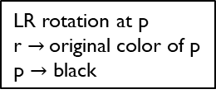
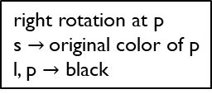
Removal: Cases
- If x is red, we are done!
- If x is black with a red child, recolor the child and we are done.
Sibling
Red
Black
right rotation at p
recoloring p, s
children
p
Sibling
s
x
red left
both black
red right
l
r
right rotation at p
s $→$original color of p
l, p $→$ black
LR rotation at p
r $→$original color of p
p $→$ black
parent
red
black
p $→$ black
s $→$ red
s $→$ red
del x, x=p

Slide 139
Example
70
60
90
p
93
43
65
85
s
x
98
20
50
63
68
75
88
13
30
48
55

Slide 140
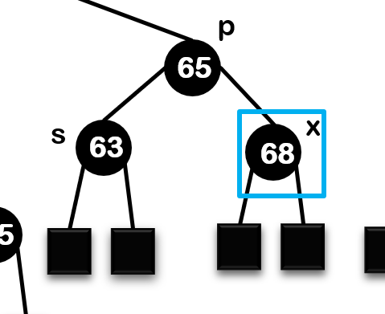
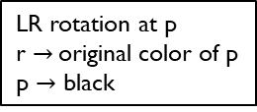
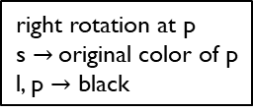
Removal: Cases
Sibling
Red
Black
right rotation at p
recoloring p, s
children
red left
red right
both black
right rotation at p
s $→$original color of p
l, p $→$ black
LR rotation at p
r $→$original color of p
p $→$ black
parent
red
black
p $→$ black
s $→$ red
s $→$ red
del x, x=p

Slide 141

Removal: Cases
Sibling
Red
Black
right rotation at p
recoloring p, s
children
red left
red right
both black
right rotation at p
s $→$original color of p
l, p $→$ black
LR rotation at p
r $→$original color of p
p $→$ black
parent
red
black
p $→$ black
s $→$ red
s $→$ red
del x, x=p

Slide 142
Example
70
60
90
p
93
43
65
85
s
x
98
20
50
63
68
75
88
13
30
48
55

Slide 143
Example
70
60
90
p
93
43
65
85
50
s
63
88
98
20
75
13
30
48
55

Slide 144
Example
70
60
90
p
93
43
65
85
50
s
63
88
98
20
75
13
30
48
55

Slide 145
Example
new p
70
60
90
new x
new s
93
43
65
85
new l
50
63
75
88
98
20
13
30
48
55

Slide 146
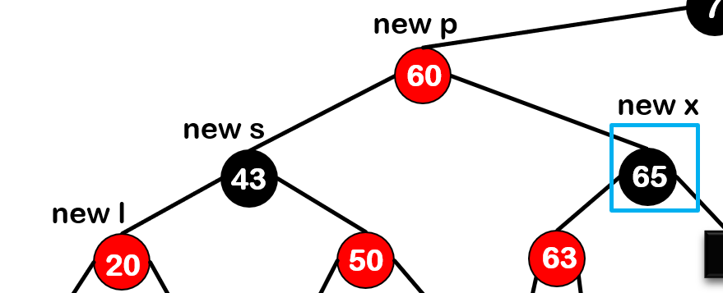


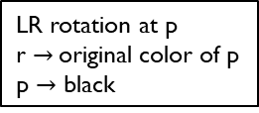
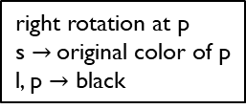
Removal: Cases
Sibling
Red
Black
right rotation at p
recoloring p, s
children
red left
red right
both black
right rotation at p
s $→$original color of p
l, p $→$ black
LR rotation at p
r $→$original color of p
p $→$ black
parent
red
black
p $→$ black
s $→$ red
s $→$ red
del x, x=p

Slide 147
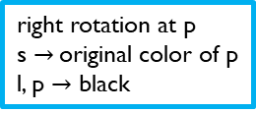
Removal: Cases
Sibling
Red
Black
right rotation at p
recoloring p, s
children
red left
red right
both black
right rotation at p
s $→$original color of p
l, p $→$ black
LR rotation at p
r $→$original color of p
p $→$ black
parent
red
black
p $→$ black
s $→$ red
s $→$ red
del x, x=p

Slide 148
Example
new p
70
60
90
new x
new s
93
43
65
85
new l
50
63
75
88
98
20
13
30
48
55
Right rotation at p

Slide 149
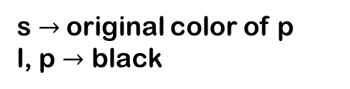
Example
new s
70
43
90
new l
new p
93
20
60
85
new x
50
65
75
88
98
13
30
48
55
63
s $→$original color of p
l, p $→$ black

Slide 150
Example
new s
70
43
90
new l
new p
93
20
60
85
new x
50
65
75
88
98
13
30
48
55
63

Slide 151
Application: Firewall Rule Matching with Red-Black Trees
A firewall has a list of rules like: Allow or block certain IP addresses or IP ranges.
Example: Block all IPs from 192.168.0.0 to 192.168.0.255.
Challenge:
These rules are often stored as ranges, and new rules can be added, removed, or updated.
When a packet comes in, the firewall must quickly find if its IP matches any rule.

Slide 152
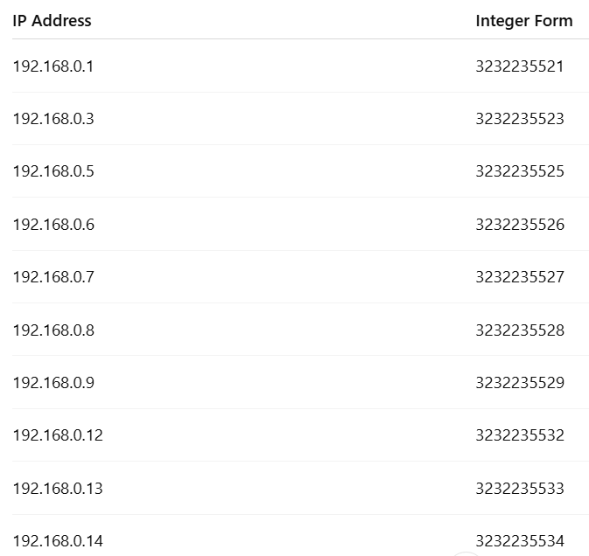
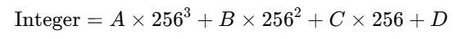
Application: Firewall Rule Matching with Red-Black Trees
If the IP address is A.B.C.D, its 32-bit integer value is:

Slide 153
Application: Firewall Rule Matching with Red-Black Trees

Slide 154
Any Question??
Thank you for Your attention!
Have a nice day!

